Slide 1
UIT2301 – Programming and Design Patterns
Lecture-01
Introduction to object-oriented Programming

Slide 2
Object-oriented
An object is a collection of data and associated behaviors.
Object-oriented
Functionally directed toward modeling objects
Used for modeling complex systems by describing a collection of interacting objects via their data and behavior

Slide 3
Object-oriented in software development
Object-oriented Analysis (OOA)
Object-oriented Design (OOD)
Object-oriented Programming (OOP)

Slide 4
Object-oriented Analysis (OOA)
What needs to be done
Set of requirements

Slide 5
Object-oriented Design (OOD)
How should be done
Implementation-specific
Requirements -> Classes and interfaces

Slide 6
Object-oriented Programming (OOP)
The process of converting this perfectly defined design into a working program

Slide 7
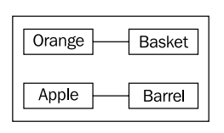
Objects & Classes
Classes: Description/ Blueprint for the objects
Description of class diagram – Unified Modeling Language (UML)
Example: Inventory system
Association is the most basic way for two classes to be related.

Slide 8
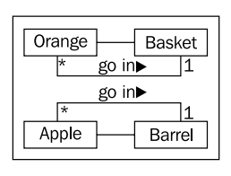
Detailing UML
Multiplicity (number of that object that can be used in the association) on both sides of the relationship.

Slide 9
Attributes and Behaviors
Objects are instances of classes that can be associated with each other.
An object instance is a specific object with its own set of data and behaviors
Data describes objects: Data typically represents the individual characteristics of a certain object.
Attributes are frequently referred to as properties.

Slide 10
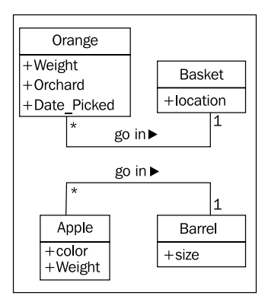
Data describes objects
A class of objects can define specific characteristics that are shared by all instances of that class.
Each instance can then have different data values for the given characteristics

Slide 11
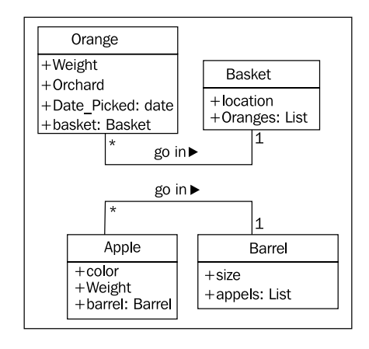
Data describes objects

Slide 12
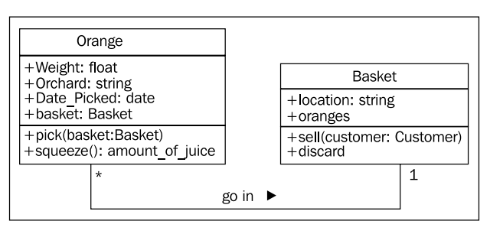
Behaviors are actions
Behaviors are actions that can occur on a specific class of objects are called methods.
Methods are like functions in structured programming – It can also accept parameters, and return values

Slide 13
Interfaces
Keywords:
Information Hiding
Encapsulation
Abstraction
Types of interfaces:
Public
Private

Slide 14
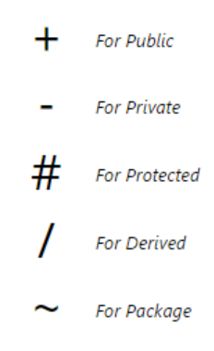
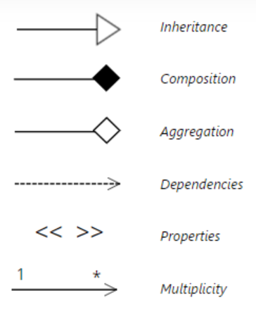
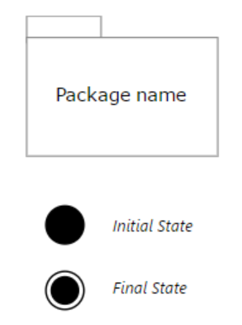
UML diagram Symbols

Slide 15
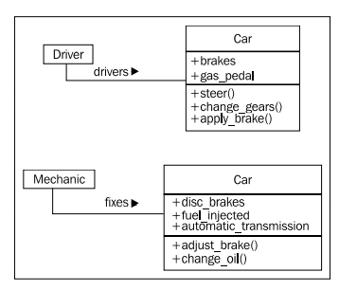
Abstraction

Slide 16
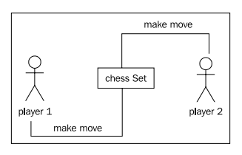
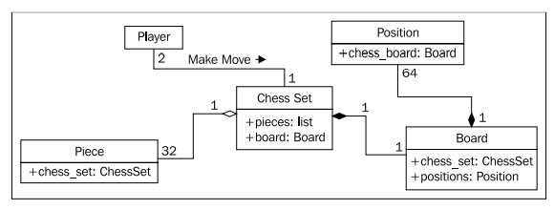
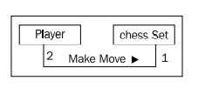
Composition and Inheritance
Highest level of abstraction

Slide 17
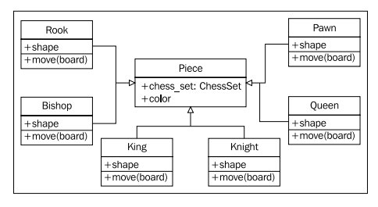
Inheritance Inheritance provides abstraction
Multiple inheritance, allows a subclass to inherit functionality from multiple parent classes

Slide 18
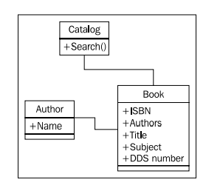
Case study: Modelling a library catalog
Basic design for the objects concretely identified

Slide 19
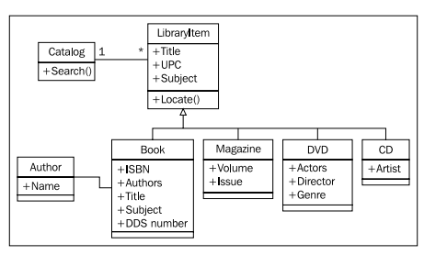
UML diagrams: Class diagram for the Case study

Slide 20
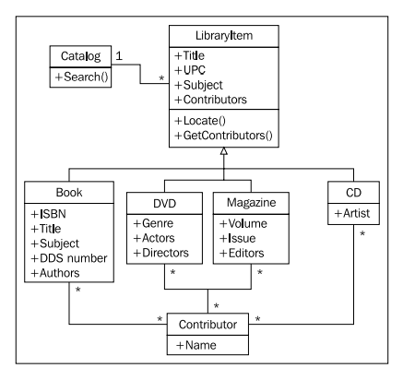
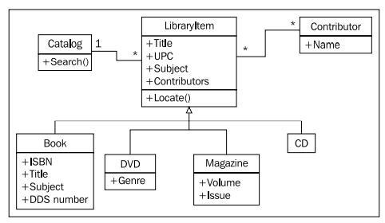
UML diagrams: Extended Class diagram for the Case study

Slide 21
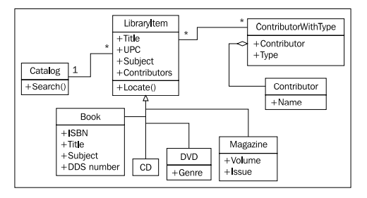
UML diagrams: Extended Class diagram for the Case study

Slide 22
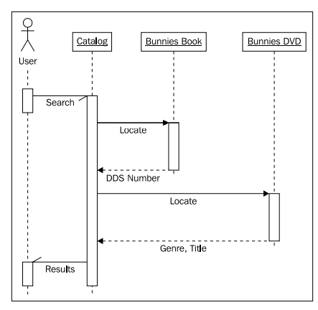
UML diagrams: Sequence diagram for the Case study

Slide 23
Books
TEXTBOOKS:
Dusty Phillips, “Python 3 Object-Oriented Programming: Build robust and maintainable software with object-oriented design patterns in Python 3.8”, Third Edition, Packt Publishing, 2018.
REFERENCES:
Matt Weisfeld, “Object-Oriented Thought Process”, Fifth Edition, Addison-Wesley Professional, 2019.
Matthias Noback, “Object Design Style Guide”, Manning Publications, 2020.
Stephen F. Lott, “Mastering Object-oriented Python”, Second Edition, Packt Publishing, 2019.
Mark Lutz, “Programming Python: Powerful Object-Oriented Programming”, Fourth Edition, O’Reilly Media, 2011.

